Slide 1




StayMate
A Serverless Student Accommodation Marketplace
Software Construction & Development Semester Project (Fall 2025)

Slide 2
Members
Mustafa Fawwaz (BSSE23036)
Hafiz M. Saad Irfan (BSSE23082)

Slide 3
Introduction
Context
Rapid increase in student migration for higher education.
Critical need for reliable hostels and meal services.
Current Scenario
Fragmented market relying on word-of-mouth or unverified offline agents.
Lack of transparency in pricing and facilities.
Motivation
To digitize the accommodation search process.
To build trust through verified listings and peer reviews.
To leverage Cloud Computing for a scalable, cost-effective solution.

Slide 4
Problem Statement
Student Pain Points
Time-Consuming: Physically visiting multiple hostels.
Lack of Trust: No verified photos or honest reviews.
Manual Process: Bookings done via phone calls/WhatsApp.
Owner Pain Points
Limited Reach: Hard to market to students outside their vicinity.
Management Chaos: Tracking requests manually on paper.
The Gap
Absence of a centralized, cloud-native platform connecting these stakeholders.

Slide 5
Aim & Objectives
Aim
Develop a scalable, serverless marketplace using AWS.
Key Objectives
Centralized Platform: Combine Hostels and Mess services in one app.
Serverless Architecture: Use AWS Lambda & API Gateway for cost efficiency.
Secure Booking: Implement an approval-based booking workflow.
Transparency: Enable student reviews and ratings.
Scalability: Use managed services (S3, RDS) to handle growth.

Slide 6
Proposed Solution: StayMate
What is StayMate?
A responsive web application for searching, viewing, and booking accommodation.
User Roles
Students: Search by city/price, read reviews, request booking.
Hostel Owners: List rooms, upload photos, approve/reject requests.
Mess Owners: Manage menus and monthly subscriptions.
Core Value Proposition
"Find Your Perfect Stay" – Verified, Transparent, and Easy.

Slide 7
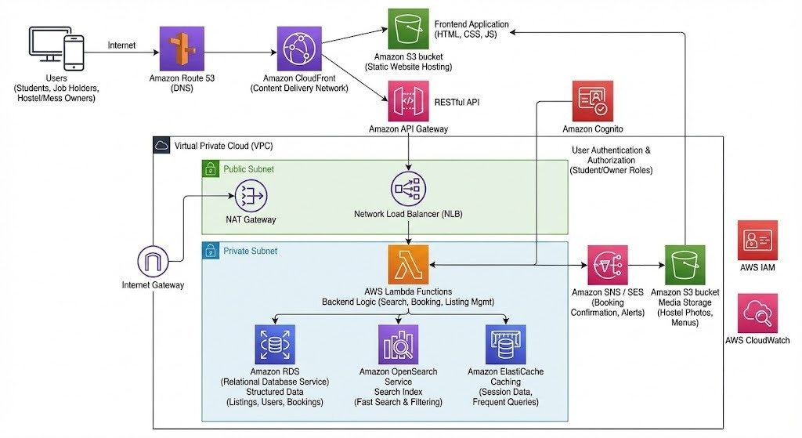
System Architecture

Slide 8
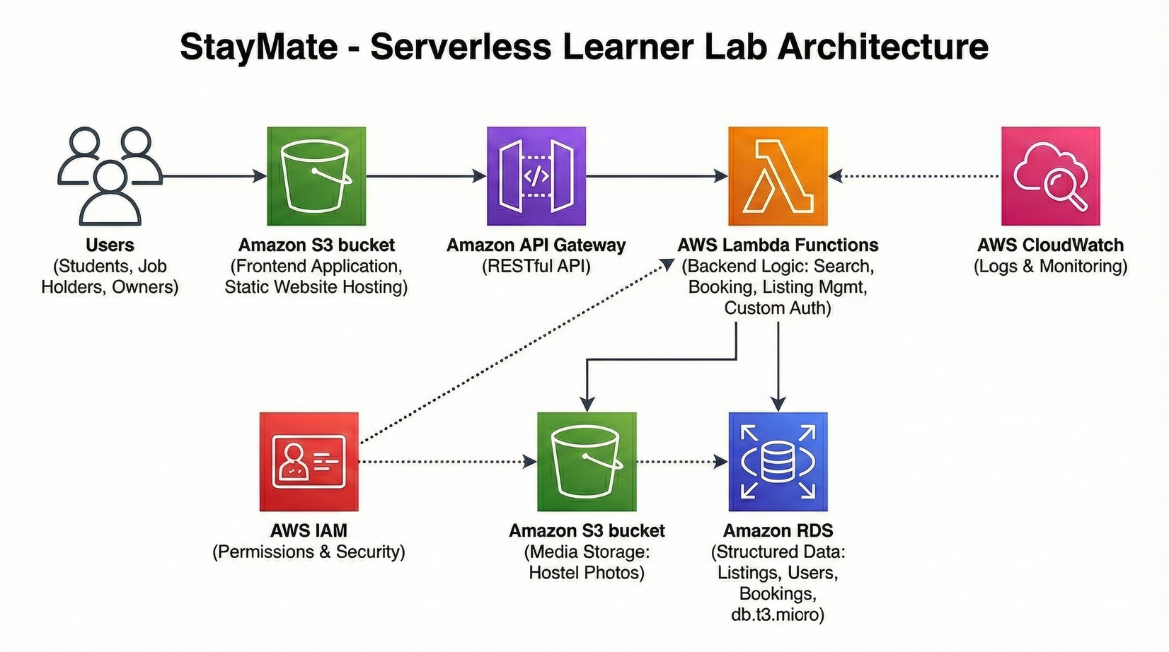
MVP Architecture

Slide 9
Key Workflows
Booking Approval Flow
Student requests a room ⟶ Status: "Pending"6.
Owner sees request on Dashboard ⟶ Clicks "Approve".
Status updates to "Booked" ⟶ Bed count decreases.
Review System
Student visits a Hostel Card ⟶ Rates 1-5 Stars + Comment.
Review appears publicly on the Hostel's detail modal.
Image Uploads
Frontend requests Pre-signed URL ⟶ Uploads directly to S3.

Slide 10
Implementation Details
Tech Stack
Frontend: React.js, Bootstrap 5.
Backend: Node.js (Express framework adapted for Lambda).
Database: PostgreSQL (AWS RDS).
AWS Services Used
S3: Hosting & Media Storage.
API Gateway: Routing & CORS configuration.
Lambda: Serverless compute.
RDS: Managed Database.
CloudWatch: Monitoring logs.

Slide 11
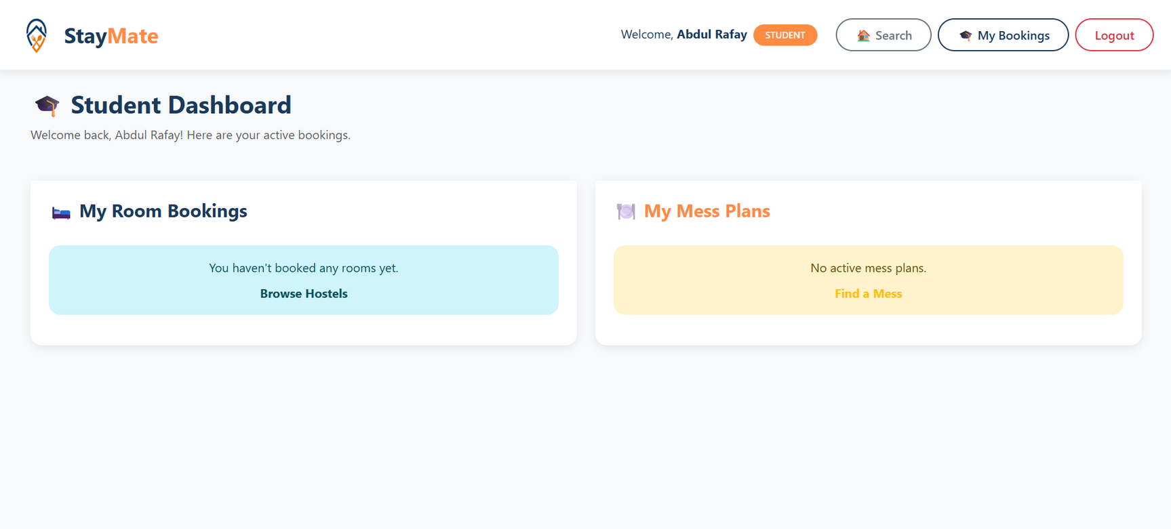
Live Demo & Results
Live URL
http://stay-mate-bucket.s3-website-us-east-1.amazonaws.com/

Slide 12
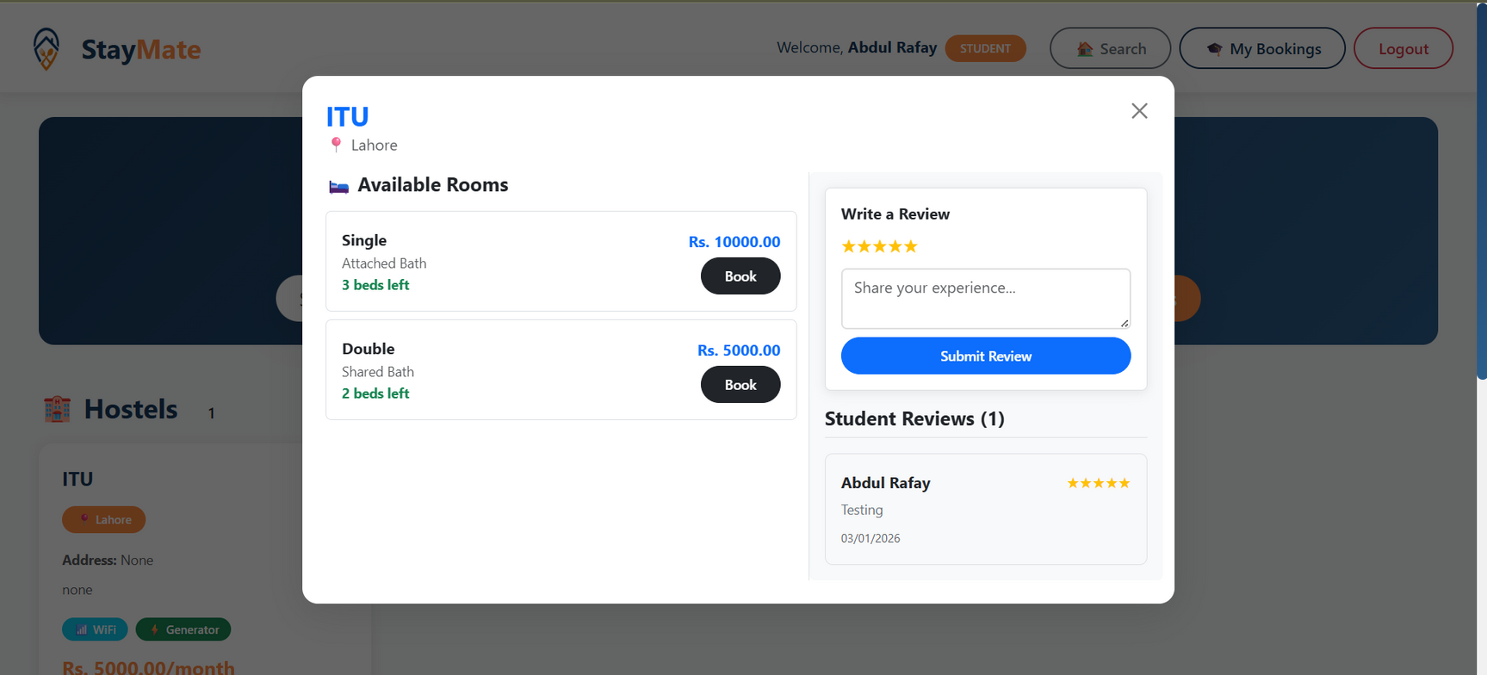
Live Demo & Results
Live URL
http://stay-mate-bucket.s3-website-us-east-1.amazonaws.com/

Slide 13
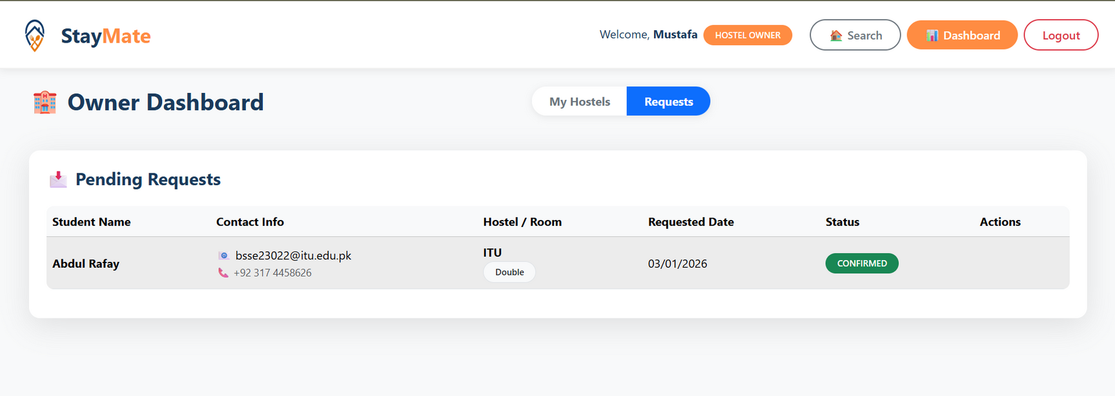
Live Demo & Results
Live URL
http://stay-mate-bucket.s3-website-us-east-1.amazonaws.com/

Slide 14
Conclusion
Successfully delivered a functional MVP on AWS Learner Lab.
Demonstrated the power of Serverless for reducing ops overhead.
Future Enhancements
Payment Gateway: Stripe integration for security deposits.
AI Recommendations: Personalized hostel suggestions.
Chat System: Real-time communication between Student & Owner.
Advanced Security: Migration to full VPC with Private Subnets.

Slide 15
Thank
You
Live URL: http://stay-mate-bucket.s3-website-us-east-1.amazonaws.com/
GitHub: https://github.com/bsse23036/StayMate.git

